Slide 1

Blackwell Data Mining Report 2022
Nick Helmers
Alex Wallace
Richard Valades

Slide 2
What is Data Mining?
Data mining is the process of finding anomalies, patterns and correlations within large data sets to predict outcomes. Using a broad range of techniques, you can use this information to increase revenues, cut costs, improve customer relationships, reduce risks and more.
Data mining allows you to:
Sift through all the chaotic and repetitive noise in your data.
Understand what is relevant and then make good use of that information to assess likely outcomes.
Accelerate the pace of making informed decisions.

Slide 3
Blackwell Data Objectives
The data set is comprised of a sample of 80,000 transactions from Blackwell customers aged 18-85, throughout the North, South, East, and West regions of the United States. In-store and online purchases were both included in the sample.
Do customers in different regions spend more per transaction?
Which regions spend the most/least?
Is there a relationship between the number of items purchased and amount spent?
Are there differences in the age of customers between regions?
If so, can we predict the age of a customer in a region based on other demographic data?
Is there any correlation between age of a customer and if the transaction was made online or in the store?
Do any other factors predict if a customer will buy online or in our stores?

Slide 4
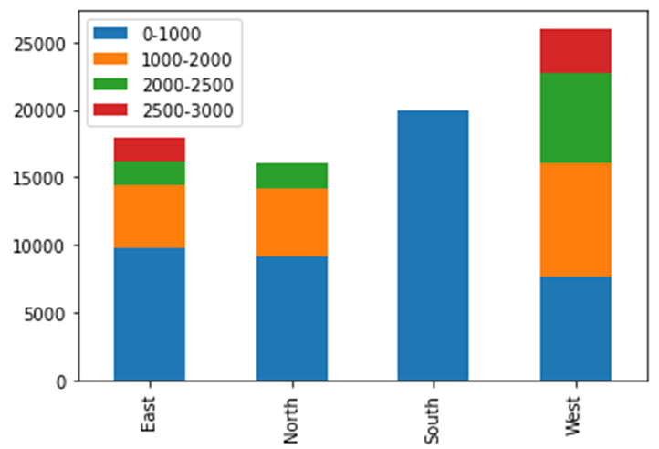
Amount Spent Per Region
Using the data given to us, we were able to separate the amount spent at Blackwell Electronics into four categories. The first thing we noticed was that while the Southern region was second in overall sales, the graph shows that they exclusively had sales in the lowest range. Though they had sales in higher ranges, there were so few that they don’t show up. While the Eastern and Northern regions came in third and fourth for overall sales, they have higher amounts spent per purchase than the Southern region. The Western region dominated both of these categories and had the highest number in overall sales and in the amounts spent per purchase.

Slide 5
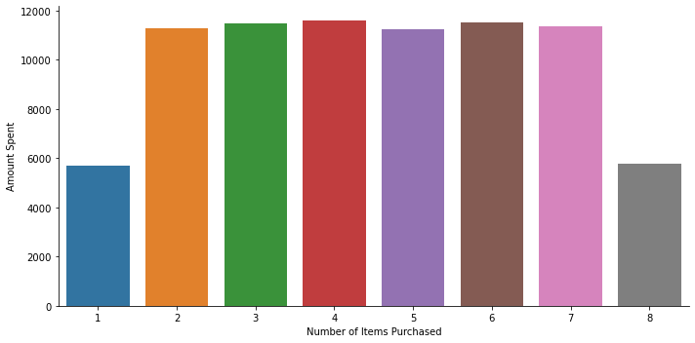
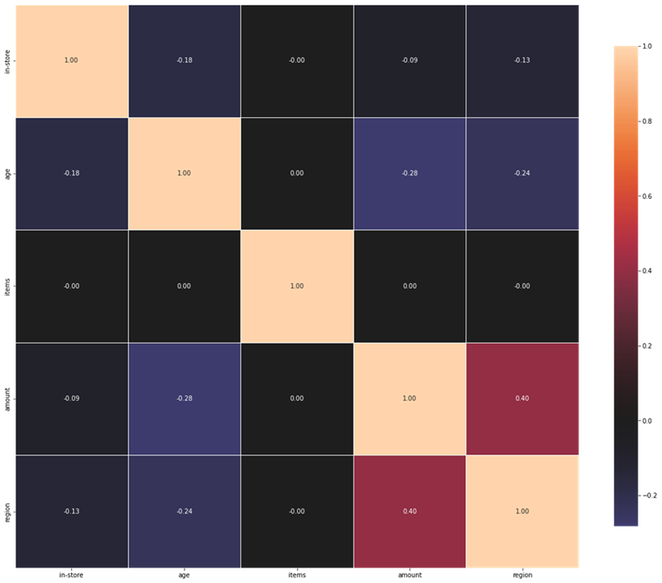
Amount Spent Per Number of Items
Using the graph above, we found that buying 1 or 8 items averaged the lowest amounts spent, while purchasing 2 to 7 items all had relatively similar amounts. We assumed that this meant there was no correlation between the two variables, and the visual to the right confirms this. In a correlation heat map, the closer you get to -1 or 1 represents a correlation, where -1 means a negative correlation and 1 means a positive correlation. Since the plot for items and amount shows us a 0, this means that there is no correlation between these two variables.

Slide 6
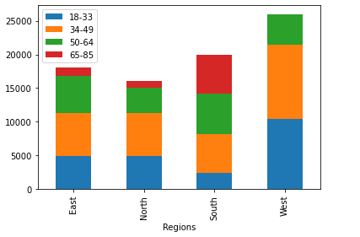
Customer Demographics
The South region contains the largest share of customers in the 65+ age range, while the West region seems to have the largest share of customers in the 34-49 range.
The West region also has the largest transaction volume.
Machine learning was used to determine if we could predict age of customer based on region.
The model accuracy was 63% which is not reliable for prediction.

Slide 7
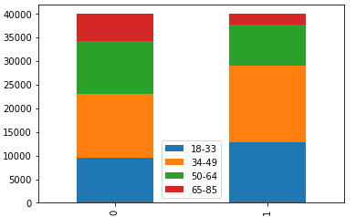
Customer Demographics
This chart shows the age groups that purchased online (0) versus in-store (1).
There is a larger share of the 65+ customers that tend to shop online.
The largest share of shoppers are in the 34-49 age group and tend to buy in-store.

Slide 8
Customer Demographics
Additional notes:
No meaningful correlation exists between age of the customer and decision to purchase in-store.
A slight correlation exists between Amount spent and Region.
Based on our Machine learning model, Region was the most significant predictor of whether customers shop in-store vs online (84%)

Slide 9
Recommendations
Data mining provides the best opportunity to understand and leverage the data we generate during the normal course of business.
By understanding patterns and insights from data, we are better positioned to make informed decisions for strategic planning.
Data mining efforts have positive ROI as they generally result in performance gains when companies implement strategic initiatives driven by data-based decision making.
Data mining activities also serve as a defensive tool within companies to understand trade markets better and take steps to preserve market share.

